Slide 1
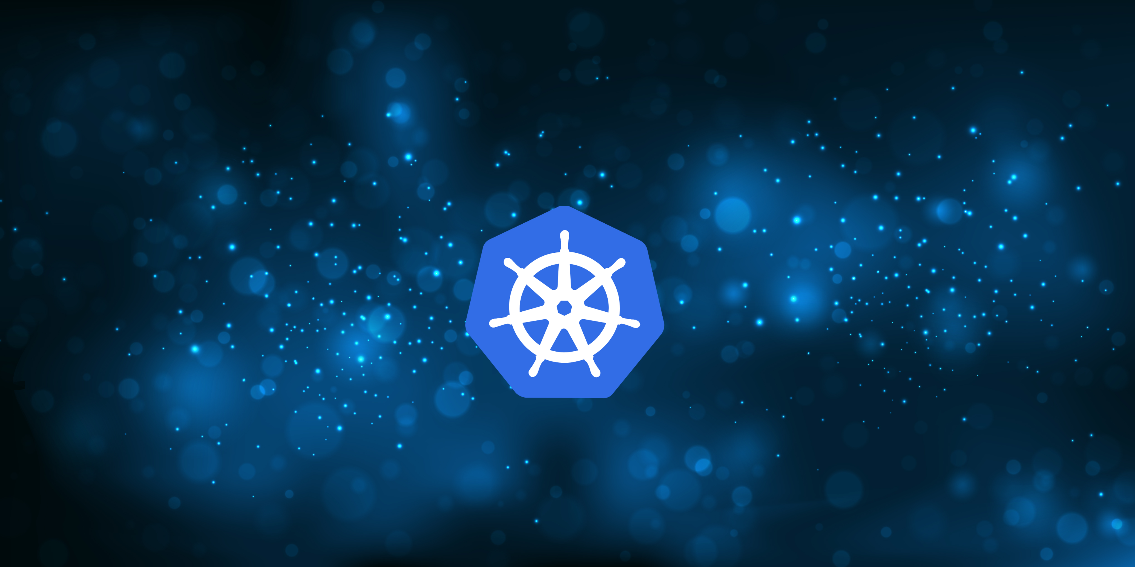
Kubernetes Basics
By Alex Bissessur

Slide 2
What is Kubernetes?
Industry standard for cluster computing
Open source technology created by Google
Kubernetes in Greek translates to “helmsman” or “pilot” of a ship
“K8S is a system for automating deployment, scaling and management of containerised applications“
- Simply an abstraction to run a cluster of computers
Performs a lot of the heavy lifting, including:
load balancing, automatic scaling, IP/port exposure

Slide 3
What is Containerisation?
Containers are similar to VMs in practice
Shares the underlying kernel, so no need for a hypervisor
Applications bundled with requirements & are isolated
Containers are extremely lightweight
(both computing power and storage)
An Nginx server with an HTML/CSS webpage < 50MB
Containers may be specialised for certain languages/ frameworks. Eg: node.js

Slide 4
How does Kubernetes Work?
It works on the basis of containers
K8S is a container orchestration system
Containers are packed in pods
- Pods are the smallest unit for K8S
- A pod can contain one or more containers
Most of everything in K8S is defined through manifests (.yaml files)

Slide 5
How does Kubernetes Work?
Pods can be deployed to your cluster by themselves
In prod, you would use deployments instead
Deployments encapsulate pods
- They use replicasets to manage pods
- They also keep pods alive, in case the node dies
- Self healing for pods
- Rolling updates & easy rollbacks
Services then expose the pods
Pods are assigned Ips but they may be moved or deleted (eg during update) and the IP will change
Services ensure static addressing of your, well, service

Slide 6
Why Kubernetes?
Horizontal scalability – just add more computers
Redundancy from having several computers
- High availability
Maintenance without causing downtime
- Blue-green deployment
Fine control over deployments
- Can limit resources
Automating deployments (CI/CD integration)

Slide 7
Why Kubernetes?
Self-healing – replaces failed pods
Portability
- Due to containerised nature, deployments can easily be moved to different clusters
Easy to manage and manipulate
- Less workload on sysadmins
Automatic scaling of pods
- No panic when your website becomes famous

Slide 8
Why Not Kubernetes?
Simplicity
- K8S adds overhead to a project
- Docker compose + rented hosting may achieve same result
Learning Curve
- Can be negatively impactful if your devs are not familiar
Legacy Projects
- May not be suitable for microservices architecture
Infrastructure limitations

Slide 9

The Kitchen

Slide 10
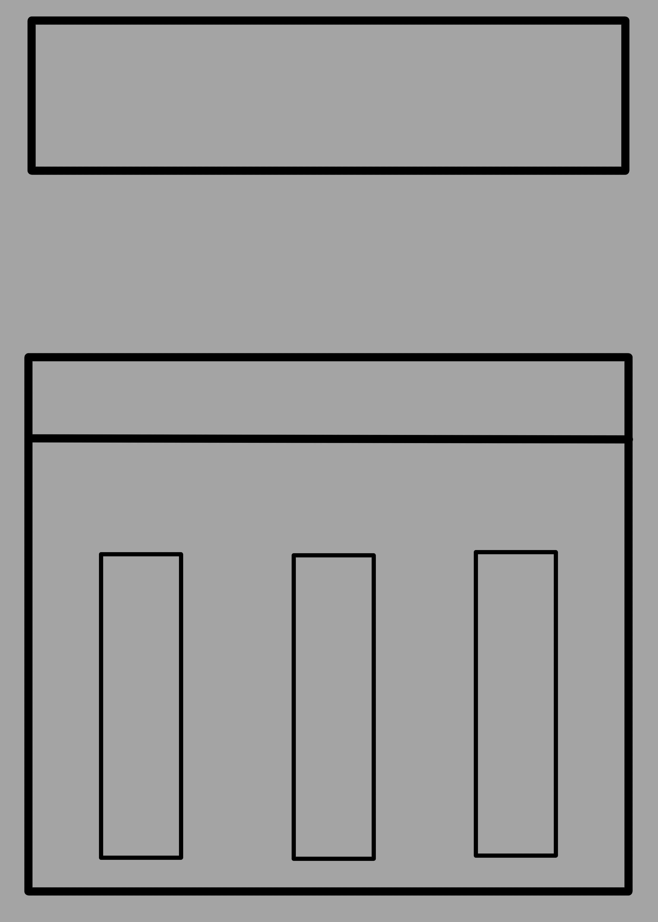

Slide 11
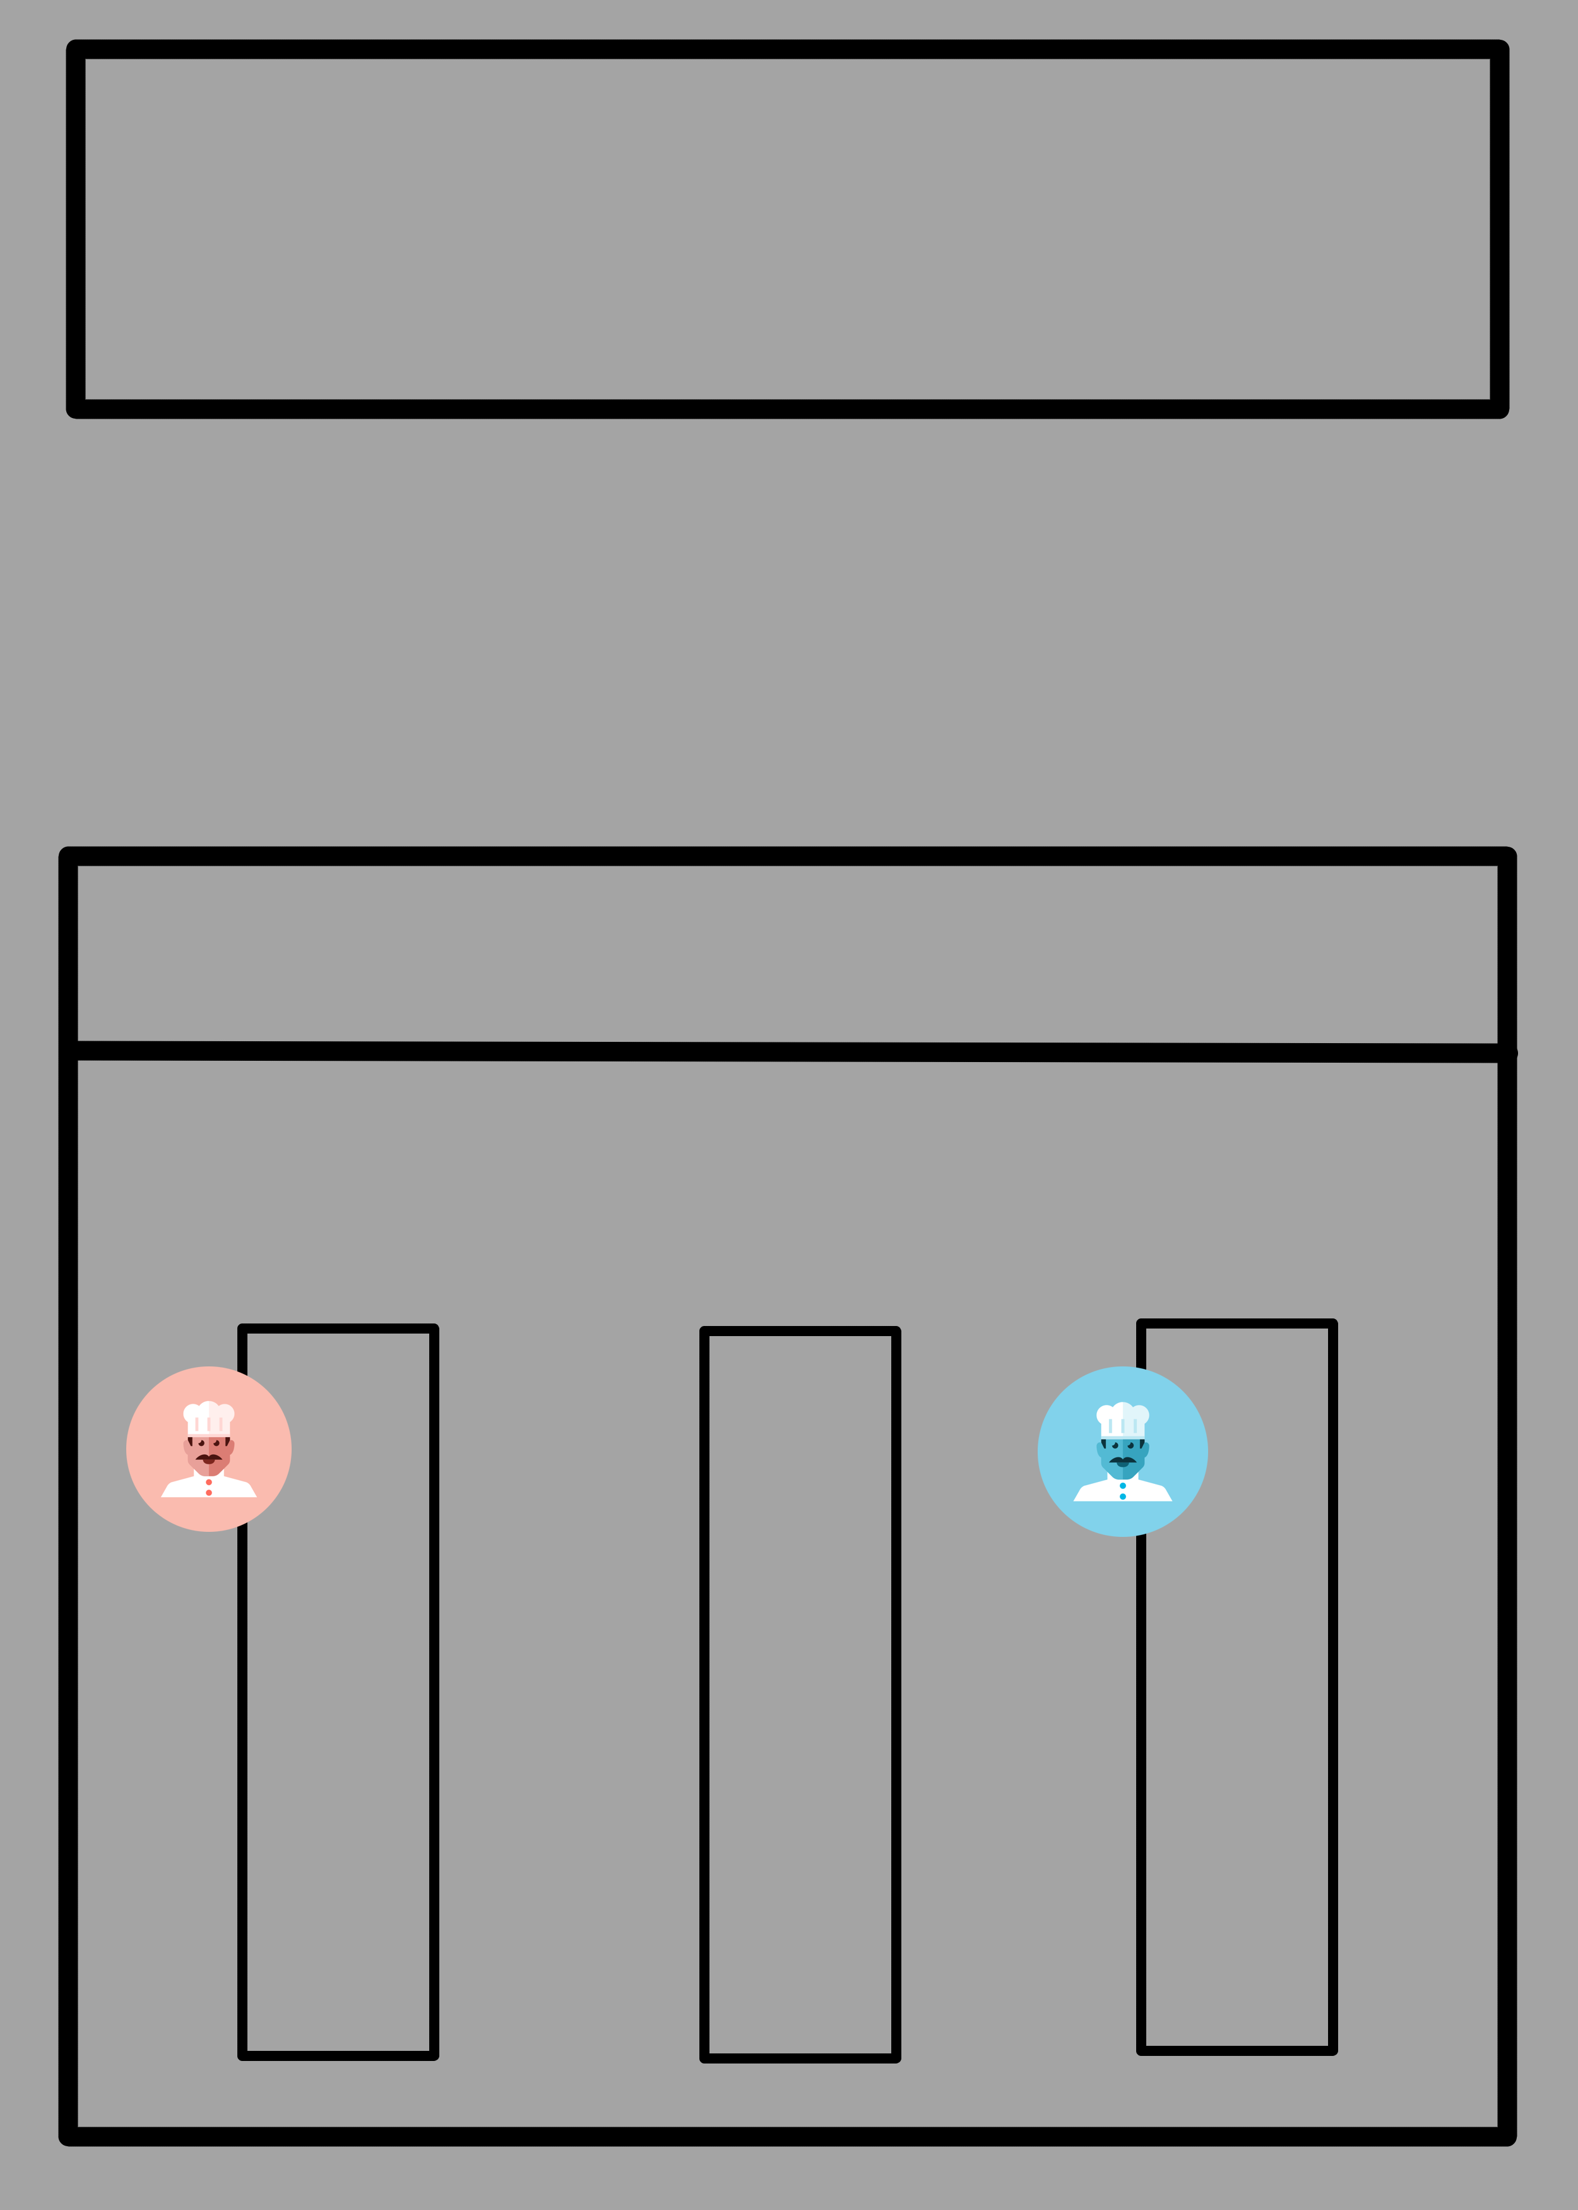

Slide 12
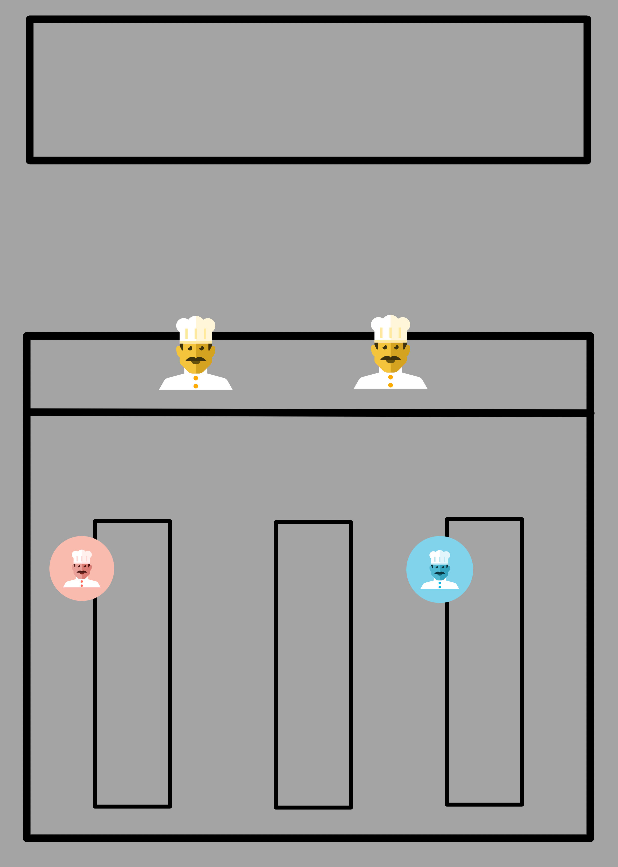

Slide 13
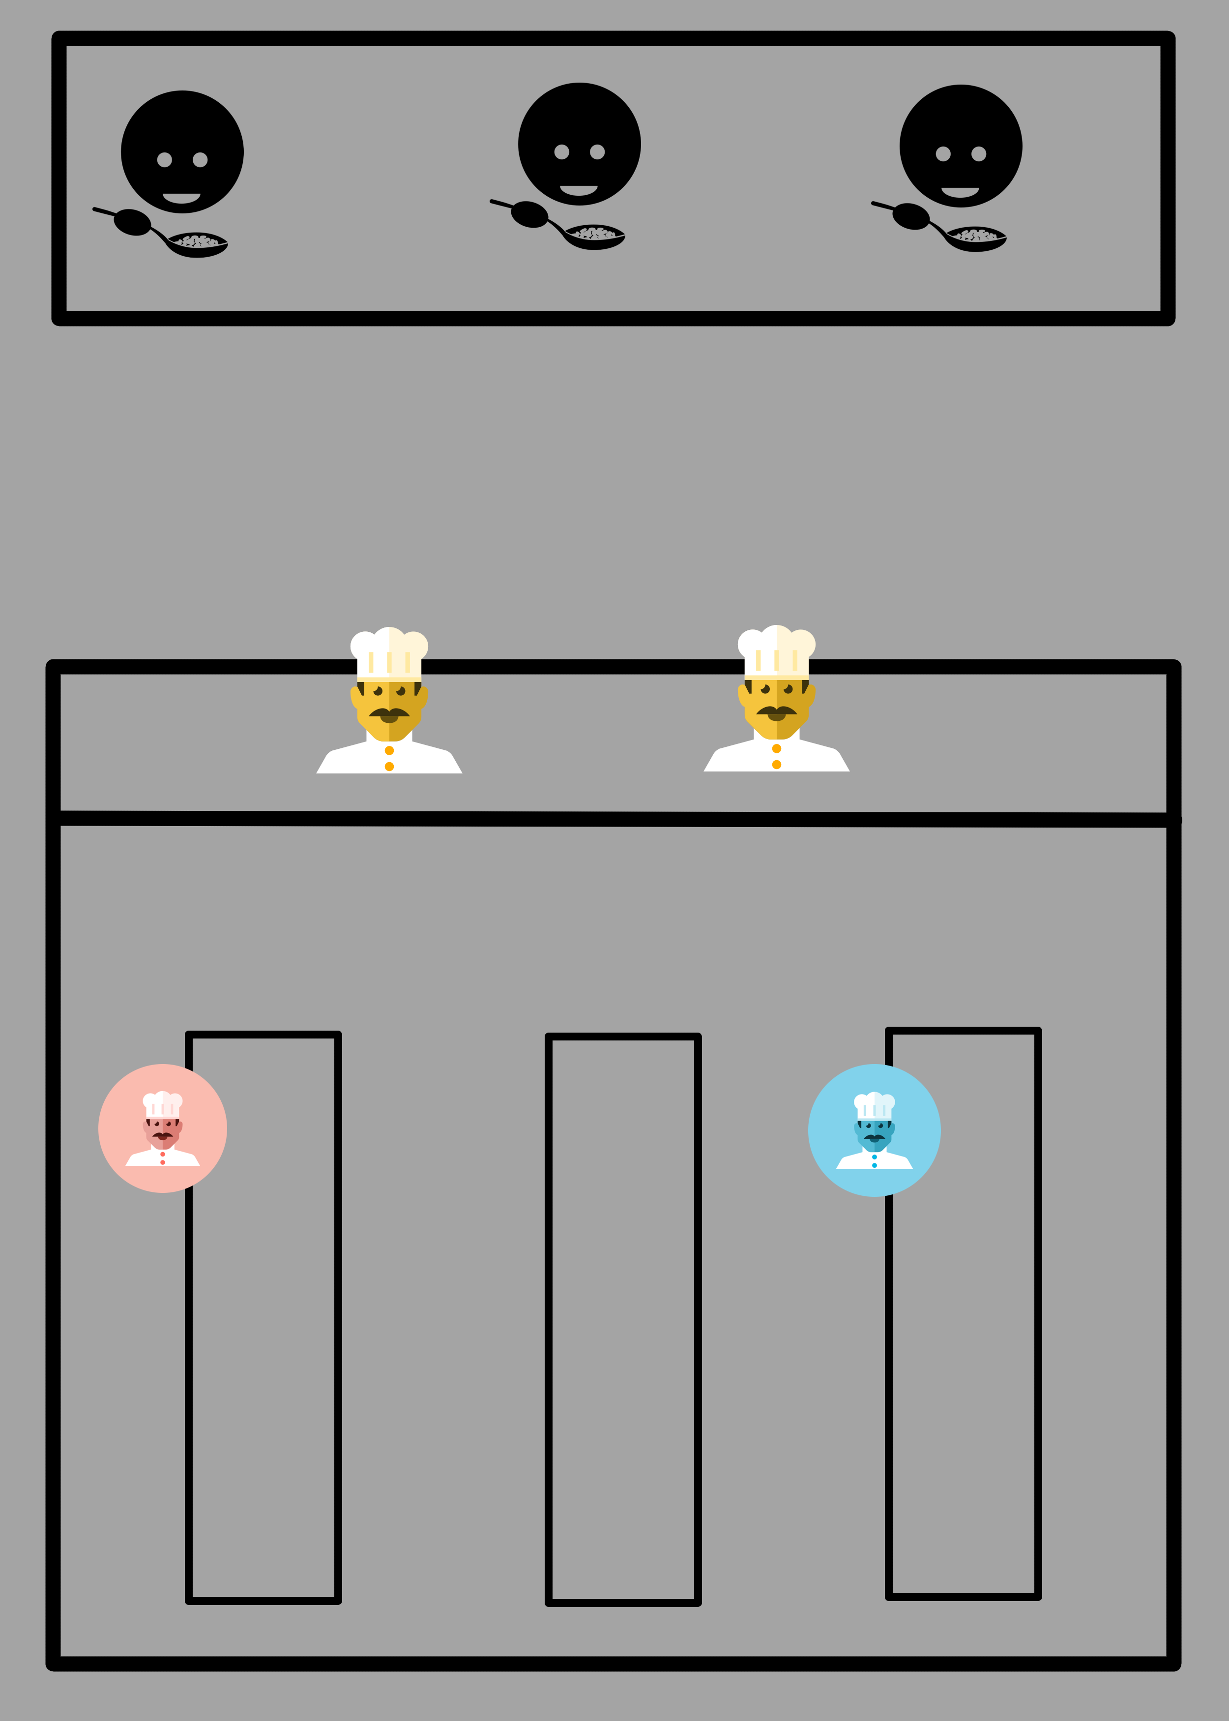

Slide 14
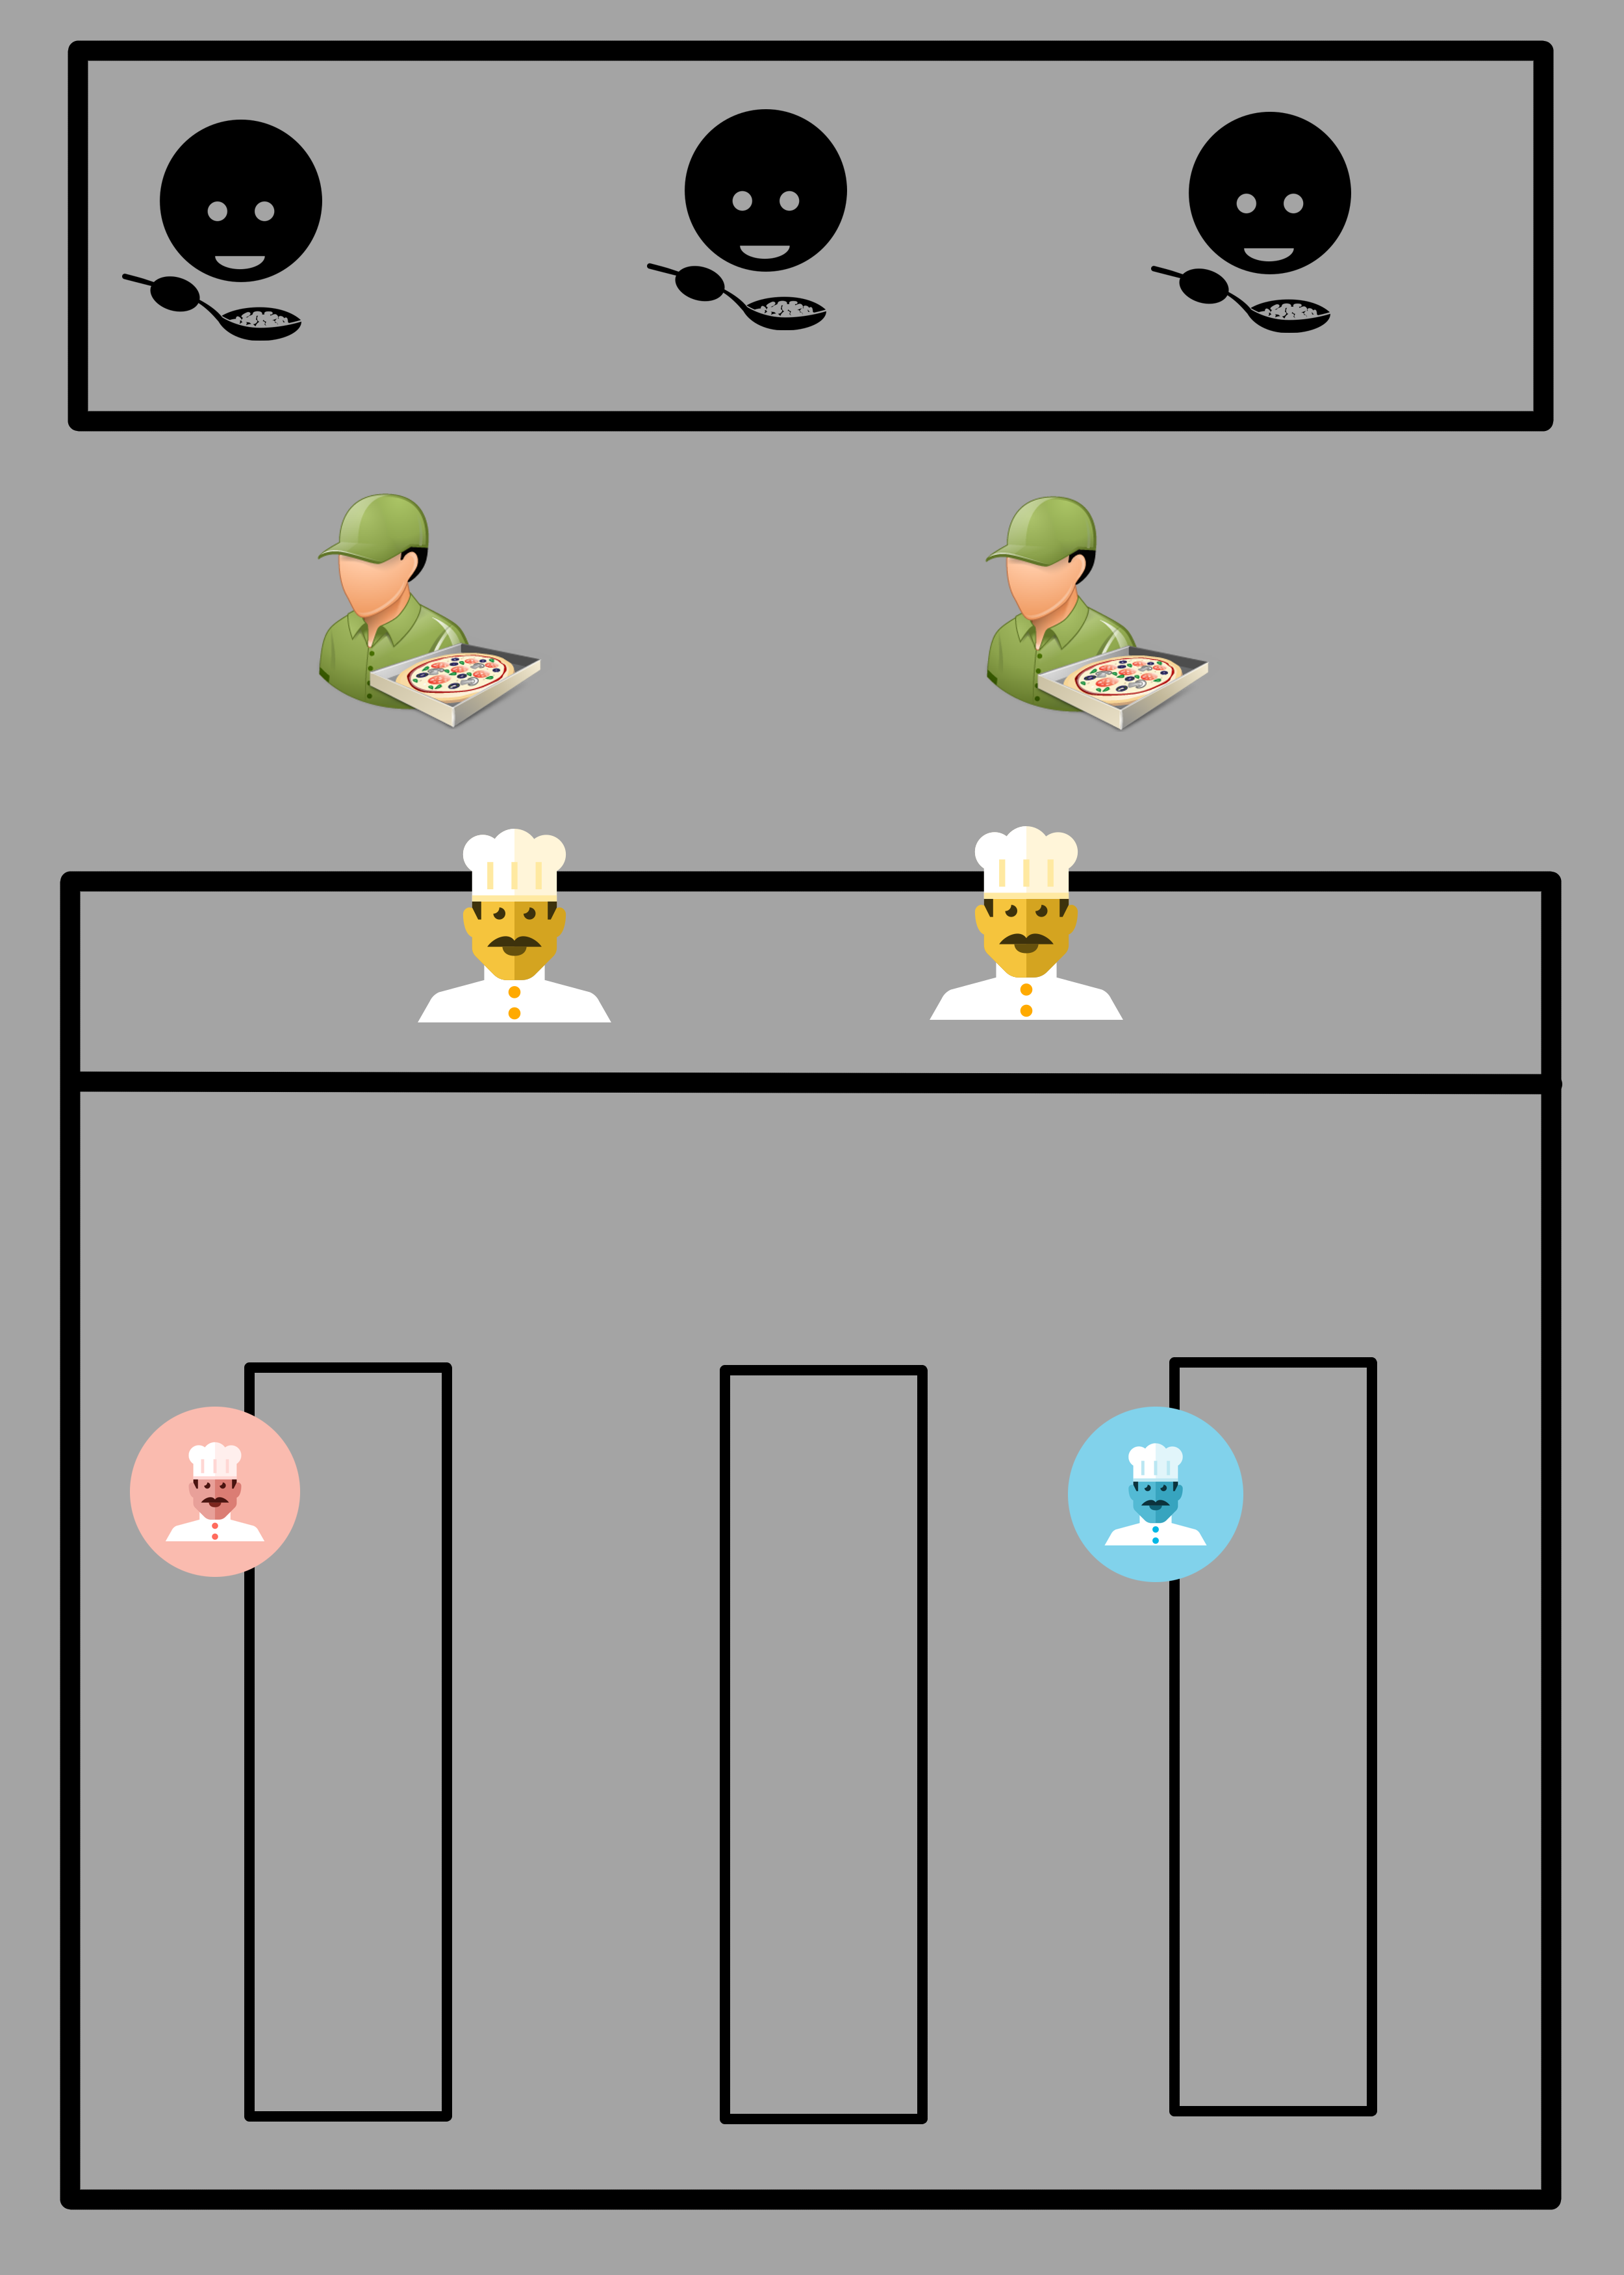

Slide 15
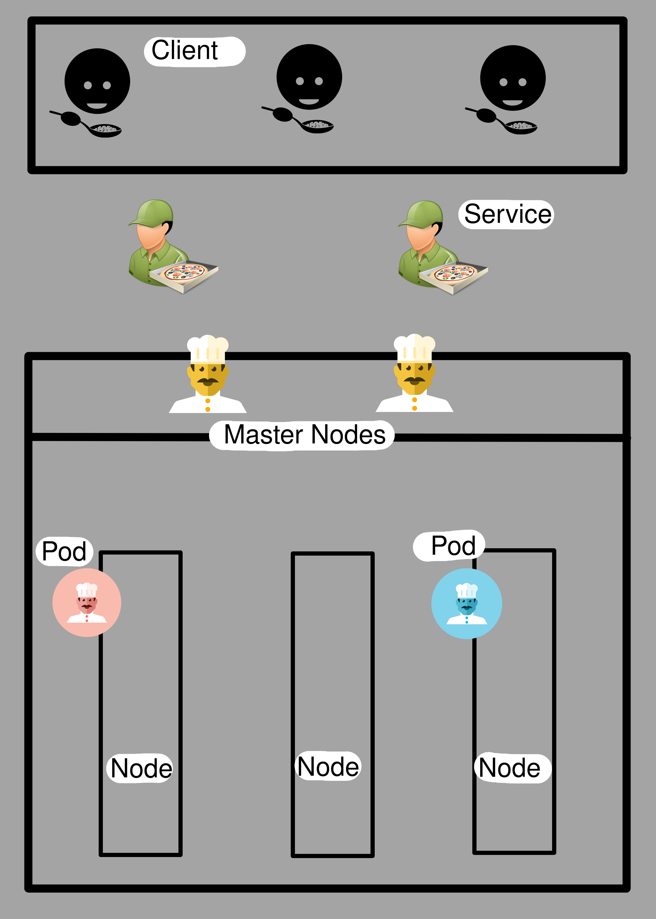

Slide 16
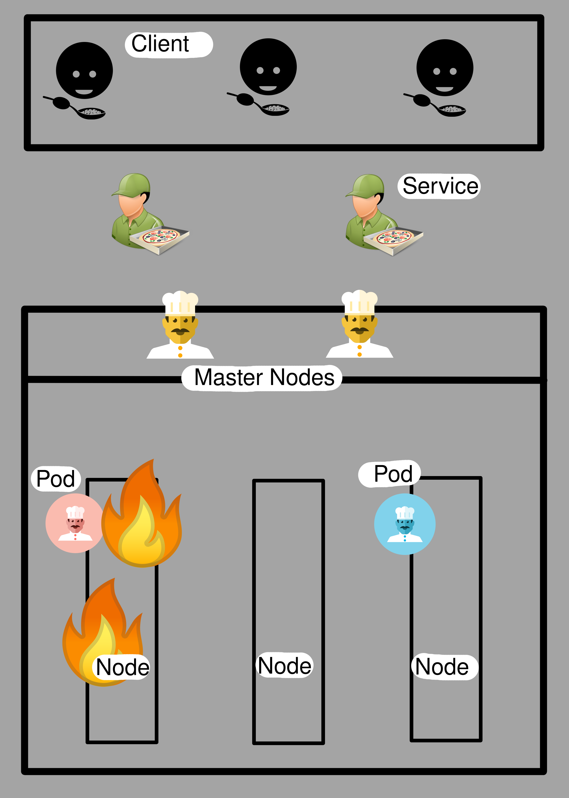

Slide 17
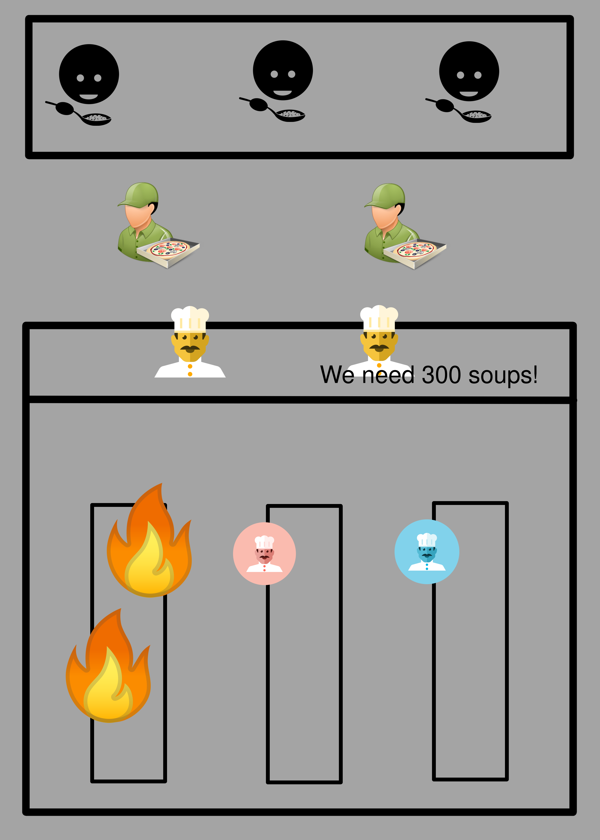

Slide 18
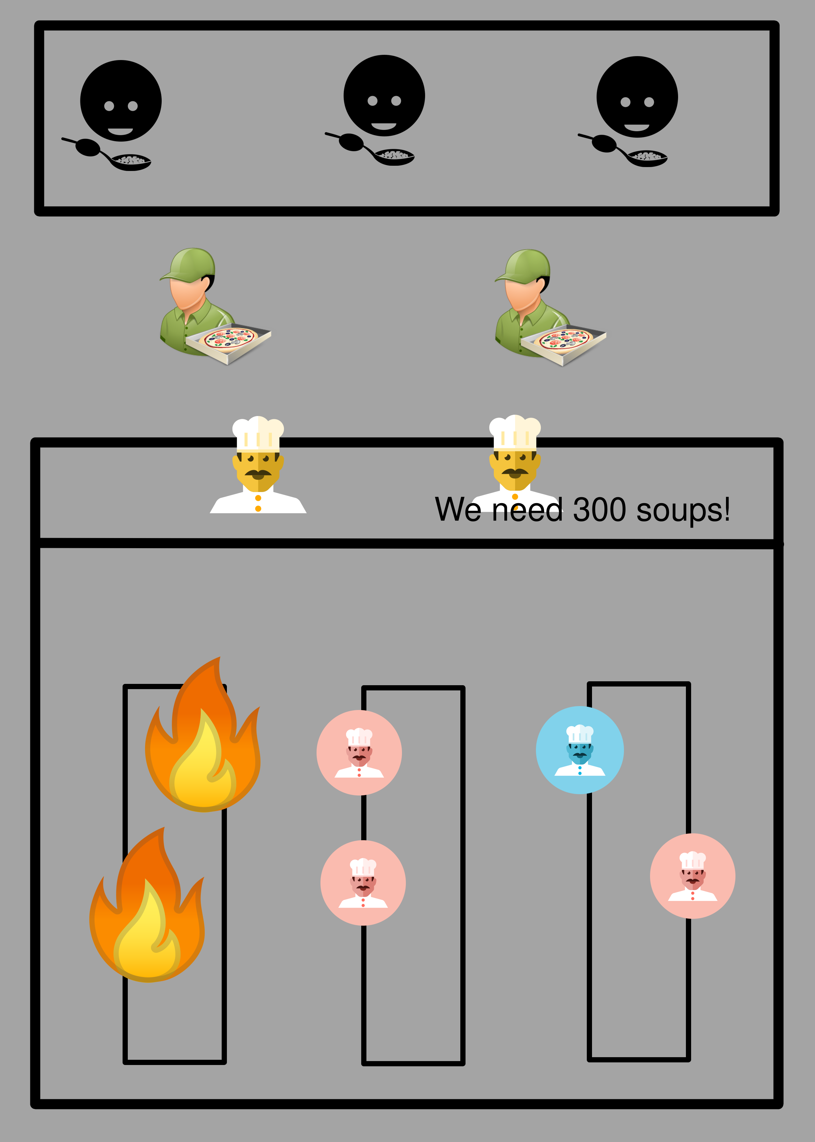

Slide 19
Demo

Slide 20
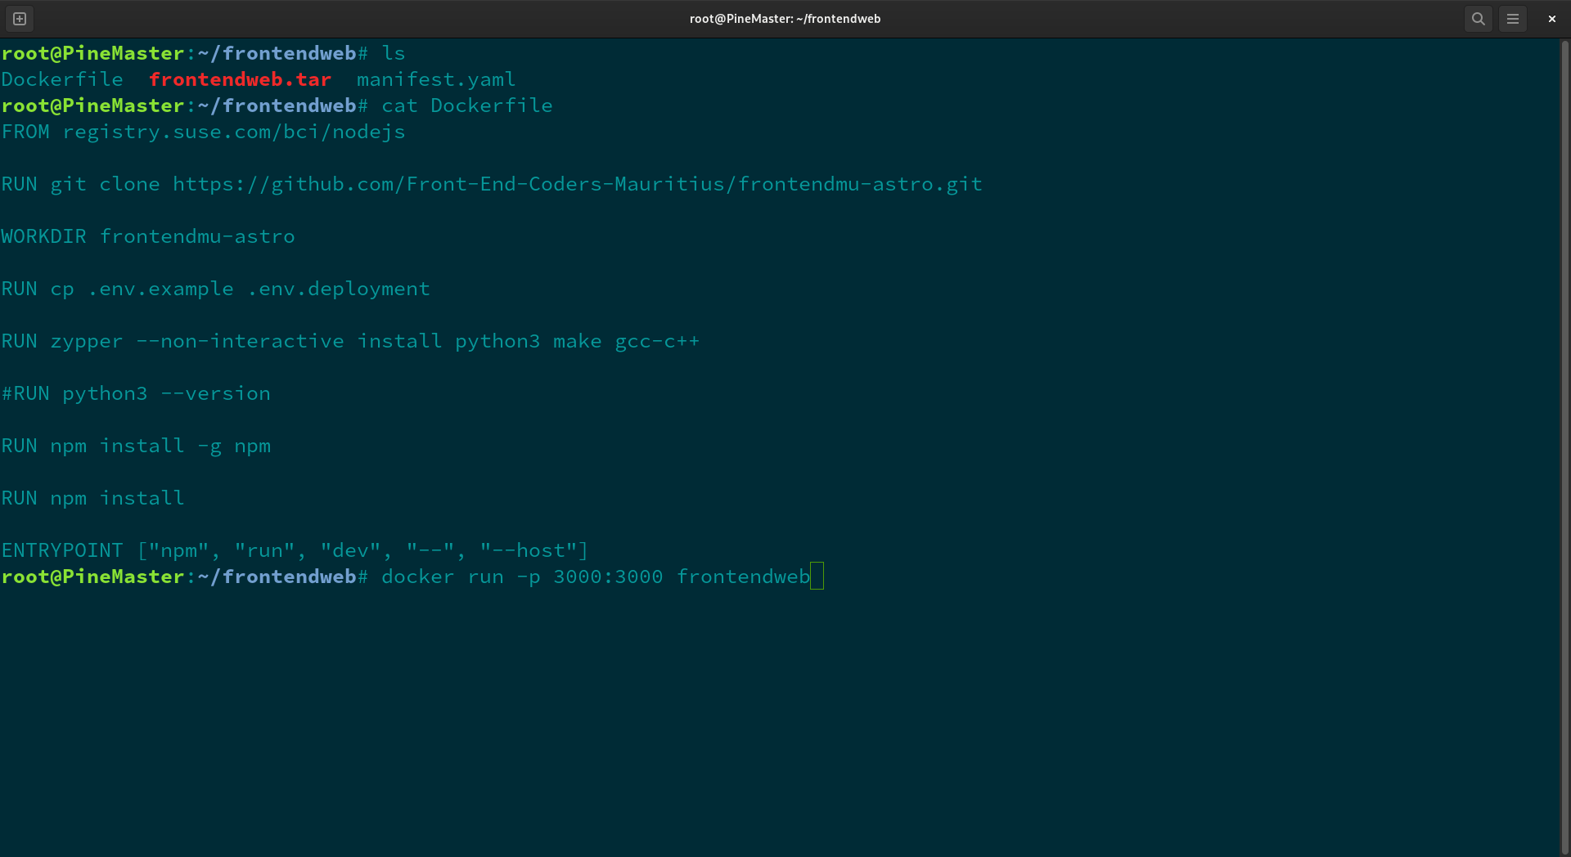

Slide 21
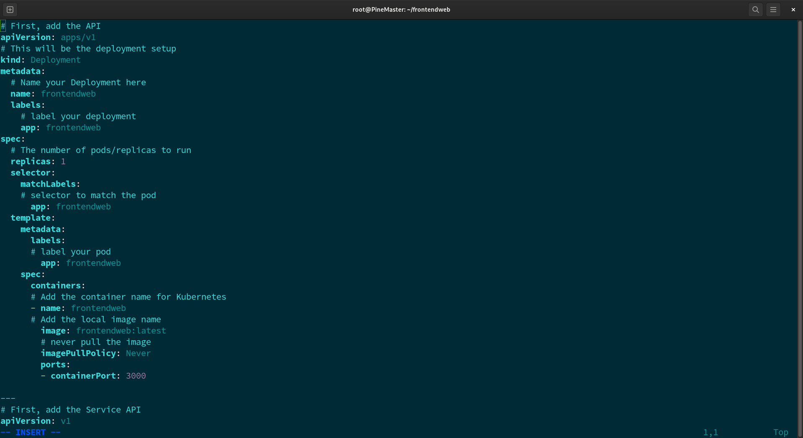

Slide 22
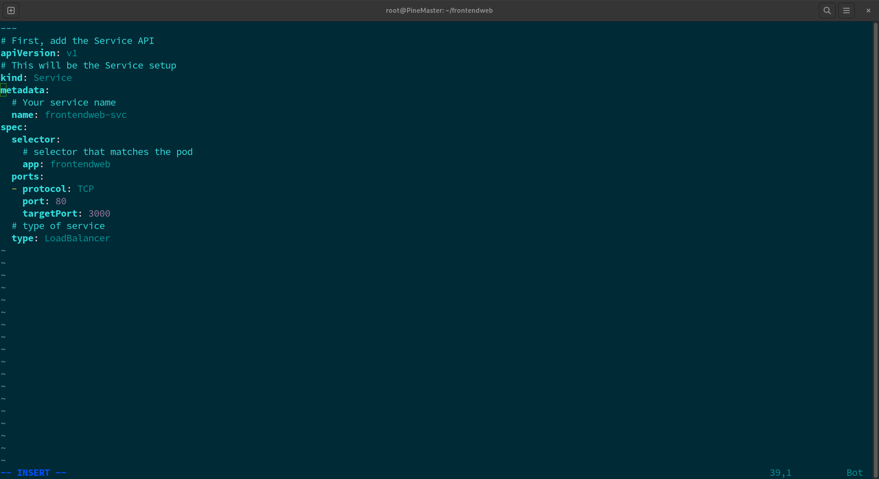

Slide 23
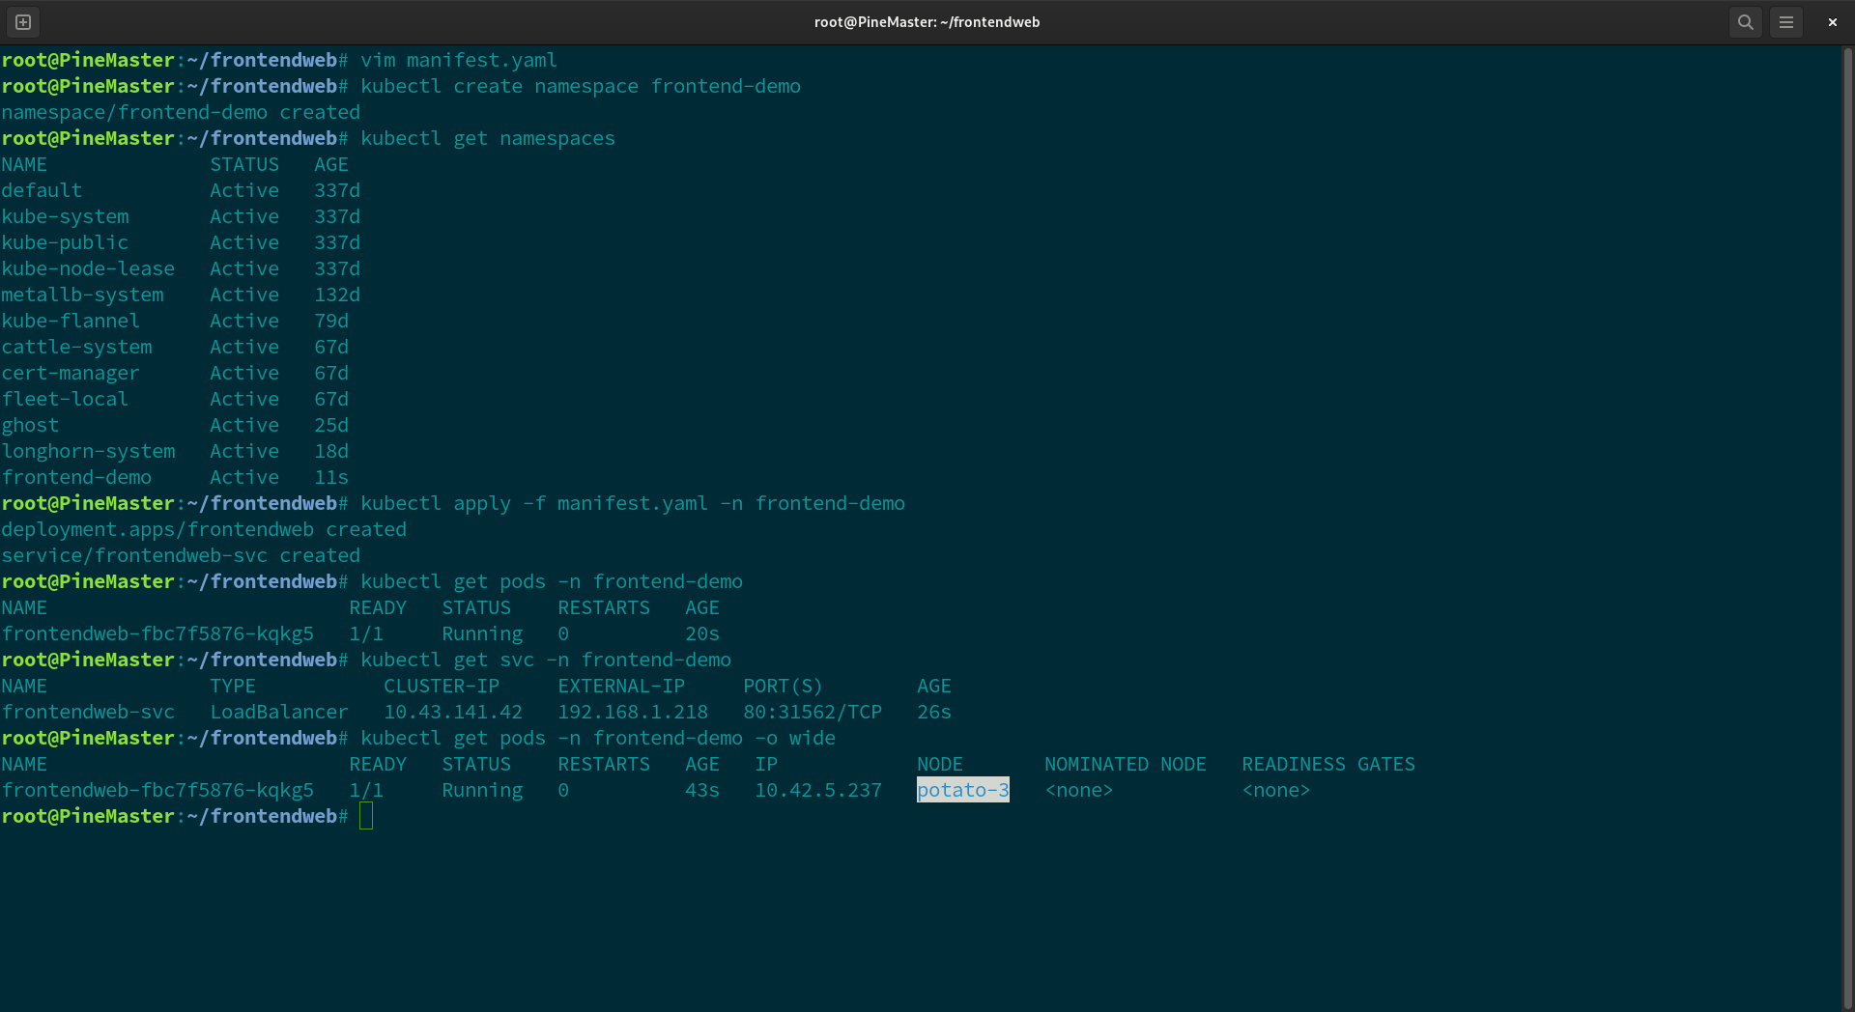

Slide 24


